Slide 1
Title II of HIPAA reminder
Includes 5 rules:
  Privacy Rule
  Security Rule
  Transactions and Code Sets Rule
  Unique Identifiers Rule
  Enforcement Rule
Notes:
Reminder of 5 parts of Title II
Wednesday discussed privacy rule
Today will discuss transactions, code set rules and security rules

Slide 2
Patient Rights...
Provider and Payers have responsibility to inform patients of rights and how to exercise rights
Inpatients shall be given information at admission.
Outpatients will be given information at their first registration.
Insurance plans upon enrollment

Slide 3
Notice of Privacy Practices (NPP)
Written Notification
Covered Entity’s legal duties
Plain language
Notes:
*an entity who has health care and non health care components ie stony brook university is a college and also stony brook university hospital/ psych services (hospital is also a covered entity)

Slide 4
PATIENT’S RIGHTS UNDER HIPAA
  Right to Notice of Privacy Practices
  Right to Request Restriction on PHI
  Right to Request Confidential/Alt. Communications
  Right to Access their PHI
  Right to Amend their PHI
  Right to an Accounting of Disclosures
  Right to File a Complaint
Notes:
*Changed from paper to electronic the stared items
Confidential/ communications- patients have the rights to be contacted at the number/ email of their choice same goes for paper mail. May want to get it at a PO BOX and not home address.
Right to access their PHI, the law that is more stringent trumps how long the office has to get to give the records. Ie- ny lets 10 days to give a response to the patient but federal is 30 days
Right to an accounting of disclosures- when info is used for research, data

Slide 5
Right to Request Restrictions
Marketing
Fundraising
Patient Directory /Clergy

Slide 6
Right to Access PHI
Access
Inspect
Obtain copy
No right to psychotherapy notes
No right of information compiled for legal proceedings

Slide 7
Right to Request Amendment
Provider must respond within 60 days
Grant or deny
Patient file a statement of disagreement

Slide 8
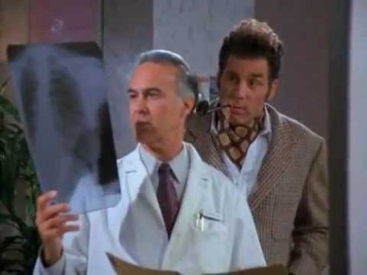
Not how requesting amendments work… (and a privacy violation)

Slide 9
Right to Receive an Accounting
Disclosures of PHI:
Date of disclosure
Name of entity
Description of PHI
Statement of purpose
Written acknowledgement
Authorization forms

Slide 10
Right to file a compliant
With the Covered Entity
With the Office of Civil Rights

Slide 11
Privacy Complaints to the Office of Civil Rights (OCR)
Most Common Complaints:
Impermissible Disclosures (gossiping to a friend outside the hospital about the medical condition of a neighbor who is a patient)
Lack of Adequate Safeguards (leaving charts/files accessible to public view, not protecting PHI on computer screens)
Refusal or Failure to Provide Access to – or a copy of – medical records
Disclosure of more than the Minimal Necessary PHI

Slide 12
Student Presentations

Slide 13
Incidental Disclosures
Incidental disclosures are not considered a violation of the regulations as long as the minimum necessary standard is met and reasonable safeguards are in place.
EXAMPLES:
Sign-in sheets, overheard conversations

Slide 14
Protecting Verbal Communications…
Find Private Locations to discuss patient information with colleagues and families.
Close doors/pull privacy curtains and talk in low voices when discussing health information with a patient or family
DO NOT talk about patients in public places (waiting areas, hallways, elevators, cafeteria)
Use, discuss and access only the minimal necessary
When leaving a message for a patient minimize the amount of information you leave on the recording – This is Stony Brook Medicine/Dr. Smith’s office calling for Mr. Jones.
Direct ALL media inquiries to Public Affairs Office

Slide 15
Protecting Written Communications…
Dispose of PHI properly
  Confidential Bins
DO NOT leave any materials containing PHI in public view (x-ray images, charts etc.)
File, store and cover documents containing Protected Health Information (PHI).

Slide 16
Protecting Electronic Communications…
Turn computer monitors so others cannot see the screen.
LOG-OFF computers
Do Not leave handheld devices/laptops unattended.
Do not share user ID’s/passwords
  Password validity policy (ie, 120 days)
Automatic log-off (session inactive for 10-15 min.)
Verify the receiving number before faxing information containing PHI
  Do not use pre-programmed buttons
Hospital and medical staff should not transmit PHI over the Internet (including email) and other unsecured networks unless using a secure encryption procedure.

Slide 17
General Organizational Responsibilities
Enforce written Policies & Procedures
Follow proper documentation retention
Verification/Authentication access identity & authority
Validate patient permission/authorization
Conduct effective training
Implement safeguards
Address complaints

Slide 18
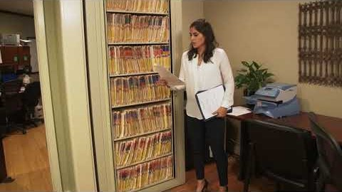
Spot the HIPAA Violations

Slide 19
Breakout groups
Discuss one incident in which a HIPPP breach has occurred and one incident that would be considered an incidental disclosure

Slide 20
Title II of HIPAA reminder
Includes 5 rules:
  Privacy Rule
  Security Rule
  Transactions and Code Sets Rule
  Unique Identifiers Rule
  Enforcement Rule
Notes:
Reminder of 5 parts of Title II
Wednesday discussed privacy rule
Today will discuss transactions, code set rules and security rules

Slide 21
Security Rule
Became enforceable on April 20, 2005
In July 2009, oversight moved from Centers for Medicare and Medicaid Services (CMS) to the Office of Civil Rights (OCR)
Protects electronic Protected Health Information (e-PHI)

Slide 22

HIPAA Security
Standards to ensure only those who should have access to e- PHI do have access
Maintains confidentiality, integrity and availability of patient information
Notes:
If stored in electronic format then e-phi
Delicate balance between keeping things super secure and having access to e-phi

Slide 23

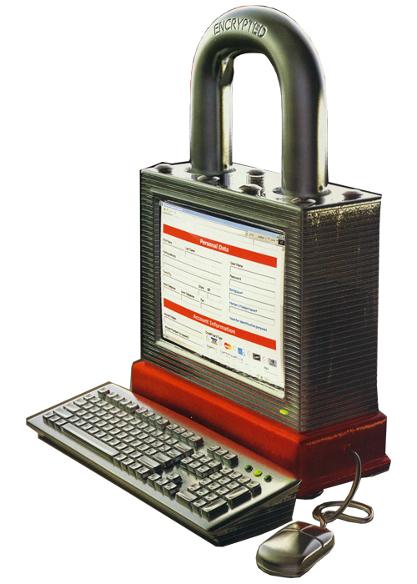
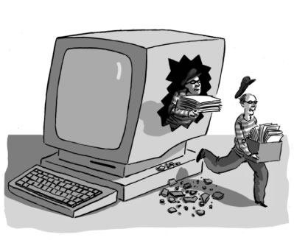
Information Security
Protecting data from accidental or intentional misuse by persons inside or outside of an organization
Purpose to protect the confidentiality, integrity & availability of patent data
Notes:
Making sure that info is used for its intended purpose and not being misused

Slide 24
What are the requirements?
Safeguards:
Administrative – policies, training, audit, etc
Physical – locks, privacy screens, etc
Technical - firewalls, encryption, virus protection , etc
Notes:
3 things that are required…admin, physical, technical....have to reasses as system changes and landscape changes (ie taking over other hospitals). There’s always an ongoing assesment and reassesment

Slide 25
Administrative Safeguards
Designate a Security Officer (required under NYS Cyber Security Law)
Implement work-force security policies and procedures for appropriate access to electronic PHI; access authorization; ensure access level is appropriate; and termination of access
Train the work force in security awareness
Establish procedures to address security incidents
Prepare a contingency plan to permit data recovery and access in the event of an emergency
Perform periodic evaluations to ensure technical and non-technical compliance to the code
Create business associate agreements for vendors who need access to Electronic Protected Health Information (ePHI)
Notes:
If e-phi is there then have to have someone who can do all these things
Who is responsible and who will be held accountable
More “paperwork” type things

Slide 26
Physical Safeguards
Lock/close office doors
Prevention of unauthorized access
Turn monitors away from public access viewing
Access control (Single Sign On, lock & log-off)
Screen Protectors
Secure workstations/fax machines
Implement physical policies and procedures that govern the receipt and removal of hardware and electronic media in and into and out of a facility.
Notes:
Prevention- use of scan cards
Lock computers, lock doors to offices, be more aware of not only patient safety but employee
Destroying hard drives, stripping data, getting rid of usb’s and other electronic media in the correct manner.

Slide 27
Technical Safeguards
Operating system / software security patches / upgrades
Mutifactor authentication
Automatic log off/time out
Encryption technology
Mobile Device Management (MDM)
Lojack (hard-drive wipe)
Virus Protection/Anti-spy ware
Firewalls
User names/password (mnemonics)
Limitations on access (network, servers, applications)
Notes:
When don’t keep up with new system updates one is more venerable to hacking

Slide 28
Break out Groups
Discuss 1 administrative, physical, and technical safeguard you would implement in your healthcare organization if you were the privacy officer, how you think it would help and why

Slide 29
Security best practices
Texting and e-mail are not secure modes of transmission for PHI (unless encrypted)
Do not store PHI on local hard-drives
Do not store PHI on mobile devices unless the PHI is encrypted and password protected
Keep your access safe (username/password)
Log-off (multiuser workstations) or lock (single user workstations) prior to leaving the workstation unattended
Be careful what you click!
Notes:
PHI always needs to be on secure share…encrypted
Multiuser workstations....keep someone at their place when they log off...can have multiple people use at once.

Slide 30
Title II of HIPAA reminder
Includes 5 rules:
  Privacy Rule
  Security Rule
  Transactions and Code Sets Rule
  Unique Identifiers Rule
  Enforcement Rule
Notes:
Reminder of 5 parts of Title II
Wednesday discussed privacy rule
Today will discuss transactions, code set rules and security rules

Slide 31
Transactions and Code Sets Rule
Governs how the health care industry conducts business electronically - standardizes
Electronic Data Interchange (EDI)
Healthcare had lagged behind many other industries such as banking in regards to EDI

Slide 32
What Constitutes a Transaction?
Transmission of information between two parties
  Health Care Claims
  Health Care Payments
  Coordination of Benefits
  Health Care Claims Status
  Enrollment in a Health Plan
  Eligibility for a Health Plan
  Health Plan Premium Payments

Slide 33
Examples of how Protected Health Information may be Sent:
Internet (secure protocol such as https, SFTP)
Phone lines (faxes)
CD/DVD (password protected)
USB/thumb drives (encrypted)

Slide 34
HIPAA 5010 Rule
ASC X12 Version 5010 went into effect January 1, 2012
Pervious version was Version 4010-A1

Slide 35
Benefits of Standardized Transactions and Code Sets
Reduction in handling and process time
Elimination of the risk of lost paper documents
Elimination of the inefficiencies of handling paper documents
Improvement of overall data quality
Decreased administrative costs
Efficient coordination of benefits
Enhanced data privacy and security
Easier Fraud Detection

Slide 36
The Following Codes Sets are Used in HIPAA Transactions:
ICD-11-CM codes - International Classification of Diseases - Clinical Modification (Diagnoses) - Jan 1, 2022
ICD-11-PCS codes - Procedural Classification System (In-patient Procedures)
HCPCS codes - Healthcare Common Procedure Coding System
CPT-4 codes - Current Procedural Terminology
CDT codes - Code on Dental Procedures and Nomenclature
NDC codes - National Drug Codes
Notes:
HCPCS: Identifies Products, Supplies and Services

